Slide 1

Adapting the Squad Model at IBM: DevOps and the IBM Marketplace
Ann Marie Fred
Senior Software Engineering Manager and DevOps Coach
IBM Digital, Marketplace Engineering
Place
Your
Picture
here
November 3, 2016

Slide 2
Objectives
This session will cover:
A bit of history
Where the Marketplace started and why it needed an overhaul
How we re-structured the organization
How we modernized the website infrastructure
How we integrated design into the continuous delivery process
Big challenges we face going forward

Slide 3
IBM Universal Marketplace
My position within IBM:
Digital Business Group
Digital Platform Engineering - VP
Commerce Platform Engineering - Director
Development Manager for 2 Squads - Me
Discovery, Navigation and Search UI Squad
Storefront Experience Squad
What we deliver: https://www.ibm.com/marketplace

Slide 4
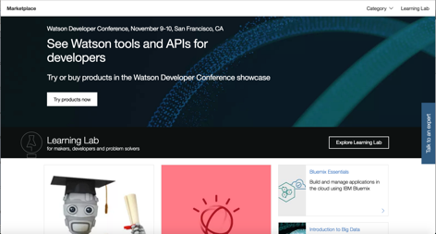
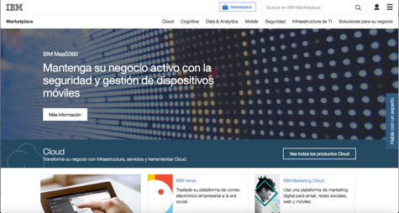
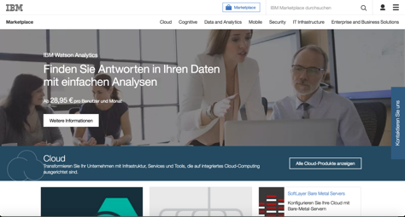
Marketplace Landing Page

Slide 5
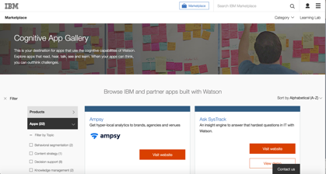
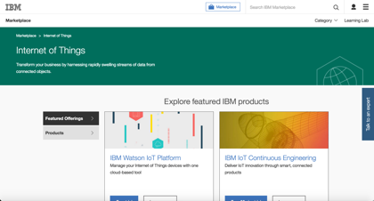
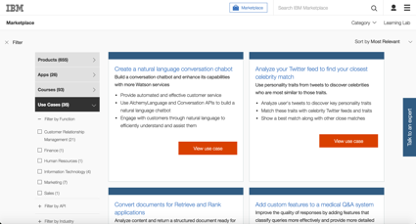
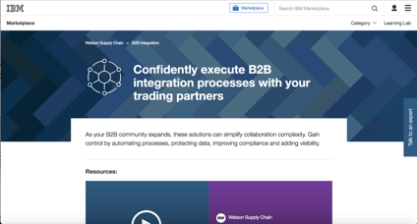
Search and Navigation Pages

Slide 6
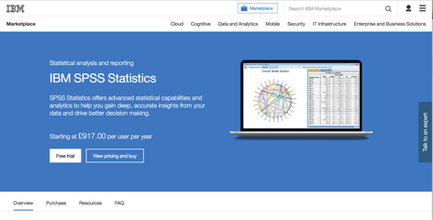
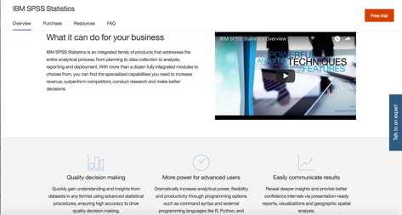
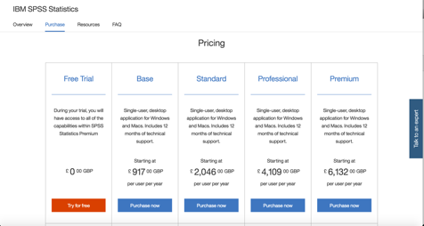
Product Details Pages

Slide 7
Introduction
Why is DevOps important to IBM?
To be more competitive.
To streamline our engineering and operations.
To foster highly skilled, engaged teams.
To further a culture of innovation and excellence.

Slide 8
A bit of history: DevOps early adopters at IBM
IBM acquires UrbanCode
DevOps practices within legacy software teams
Rational/Tivoli DevOps advanced technology team
Service Engage
DevOps enablement training
IBM Design Thinking
IBM acquires Green Hat
Whitewater
IBM Marketplace reboot
First DevOps consulting practices
2011
2012
2013
2014
2015

Slide 9
The IBM Cloud Marketplace in early 2015
Roughly 150 products from the IBM Cloud division
Business agility issues:
Slow, manual product onboarding process took 2+ months
4 week sprint cycles: at least 4-8 weeks for a rendering change
Usability issues:
Only a few products were actually available to purchase online
Content quality was poor: text-only, garbage characters, etc.
Ugly, drab rendering that was difficult to change

Slide 10
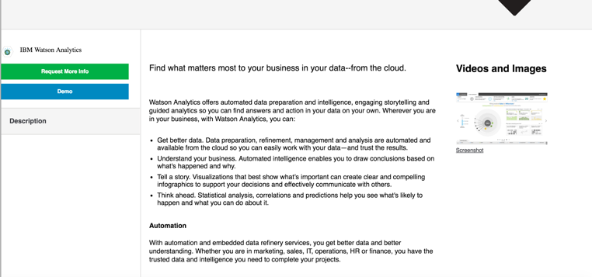
Watson Analytics – November 2014

Slide 11
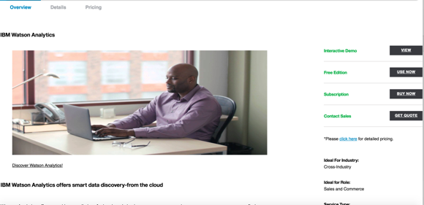
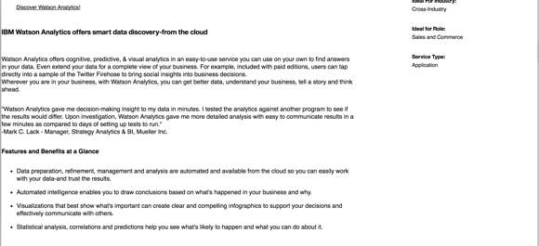
Watson Analytics – June 2015

Slide 12
Step 1: Build a more agile organization
Started a new organization more or less from scratch
Dozens of new hires
Pulled in Service Engage development team for DevOps / Continuous Delivery expertise
Pulled in Partner Marketplace team so we could sell 3rd party products
Accelerated DevOps transformation of legacy, back-end teams:
Squads that own the entire lifecycle of a service
Shorter sprint cycles, moving from 4-6 weeks to 1-2 weeks

Slide 13
Some favorite DevOps practices
DevOps Bootcamps for leadership and squad members
Continuous Delivery to IBM Bluemix PaaS
Many small deployments per day
Zero-downtime deployments using blue-green deploy
100% automated unit test coverage
Automated deployment on every merge with Travis CI
UrbanCode Deploy for complex deployments
Fast deployments (5-20 minutes) for fast repairs
Social Coding instead of Jewel Code

Slide 14
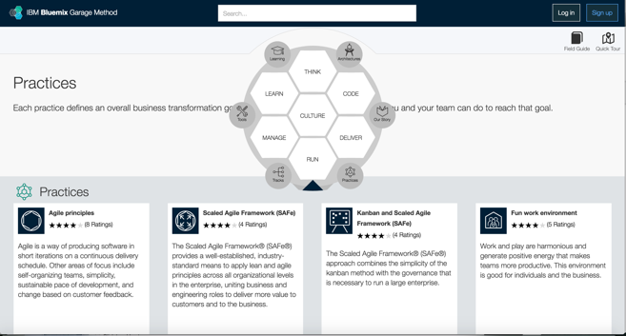
Bluemix Garage Method Reference Material
https://www.ibm.com/devops/method/category/practices

Slide 15



Heritage
Squad model
Inspired by Spotify
More later…
Just culture
Inspired by Etsy
Blameless post-mortems
Microservices
Inspired by Netflix

Slide 16

Heritage
Lean and Kanban
Inspired by Toyota
Minimum Viable Product (MVP)
Limit work in progress
Pull model

Slide 17


Heritage
Scrum
Long history of success within IBM
Helps coordinate work across squads
Weekly sprints
Rational Team Concert
Design Thinking
IBM-wide initiative
Design Thinking: Build the right thing
DevOps: Build the thing right

Slide 18
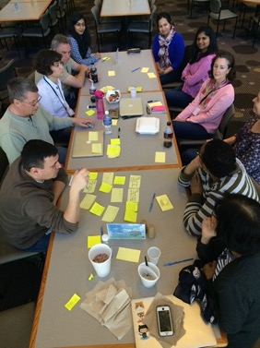
Making a huge company feel small
Our version of the squad model:
Small and focused
Co-located
Independent
Accountable
Autonomous
Self-managing

Slide 19
What makes us tick?
Squad Roles
Squad lead
Development manager
Technical lead
Full-stack developers: develop, test, deploy, operate, support
Dedicated designers (visual, UX)
Project manager
Subject matter experts

Slide 20
What is the scale?
IBM Digital Business Group (parent) is several hundred people, at least 75 squads (recently added more)
Marketplace Engineering comprises approximately 20 squads (recently added more)
The Marketplace uses on the order of 100 services, when you include the back-end systems and operational tools
DevOps adoption & “Squad-ification” varies, even within Marketplace Engineering

Slide 21
Step 2: Bake-off
May 2015, started building a new rendering platform using:
Legacy WebSphere Content Manager CMS, but headless
Exporting to a Cloudant NoSQL database
Legacy systems
Pricing/checkout/payment, subscription management, SaaS automated deployment
Fronted by improved REST APIs
The Nautilus rendering engine from Service Engage
Node/Express
Best of breed tools: Github, Jenkins, Bluemix, New Relic, Pagerduty, Slack, etc.

Slide 22
Step 3: Globalize and Localize
Added new countries/locales gradually, throughout 2016
9 languages – massive translation effort for hundreds of products
Product blacklists for each country
Unique pricing and currencies per country
Unique financing and SaaS security information per country
Localization of featured products, page banners per locale
Routing of live chat to the correct country/language and product area
Auto-detect of country of origin when none is specified

Slide 23
Step 4: Cut Over and Scale Up
IBM Marketplace reboot: May
Bake-off period
Cloud Marketplace and Service Engage
Marketplace feature parity and cutover: Oct/Nov
Universal Marketplace
Globalization
Catalog Expansion
2014
2015
2016
150 Products
750 Products
12 on SE
450 Products

Slide 24
Scale
More than 700 products, both IBM and third party
300+ have trials, 200+ can be purchased online, 100+ online courses
Roughly 50,000 different pages rendered across locales
Number of Marketplace visitors has tripled YTY
Infrastructure for web page rendering:
Product Details and Navigation Pages: ~10 Bluemix Node.js instances
100% uptime during DNS DDOS attack; Akamai cache & CDN
Similar number of Bluemix/Node instances for the Search UI (no cache)

Slide 25
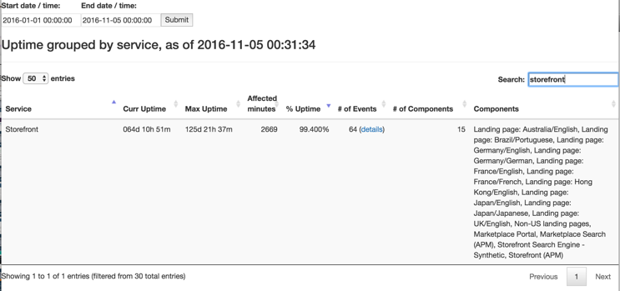
It works! 99.4% uptime vs. 96.5% uptime

Slide 26
Design Improvements
IBM Navigation Standards updated to V18
Assigned designers to individual squads
Designers create “grand visions” and incremental changes
IBM Design Language codified and socialized
Hired and trained 100s of designers
IBM Design Thinking training for 1000s
A/B testing using Optimizely
Total Customer Experience
W3 Awards “Gold” winner
2014
2015
2016
150 Products
450 Products
750 Products

Slide 27
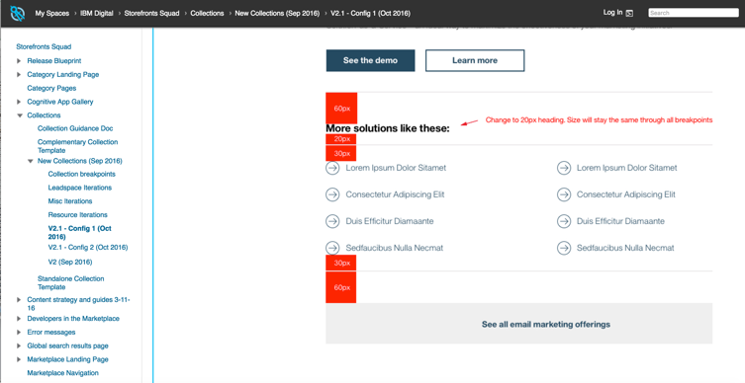
Example: Iterative Design

Slide 28
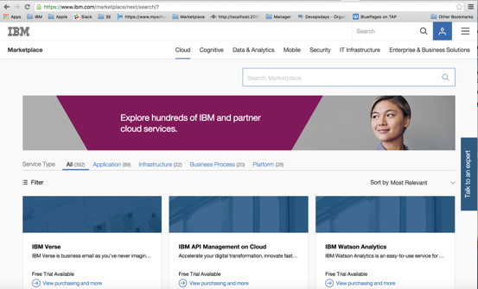
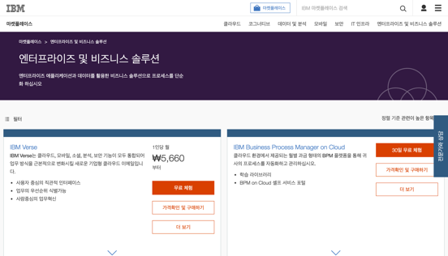
Marketplace Search: 6 Months Ago, Now

Slide 29
Watson Analytics – June 2015

Slide 30
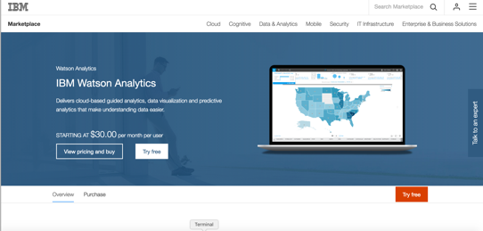
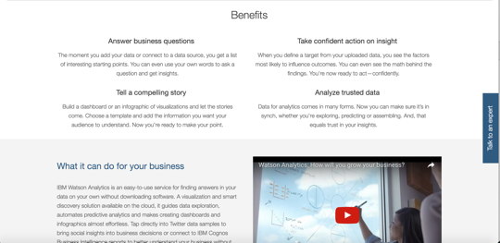
Watson Analytics – February 2016

Slide 31
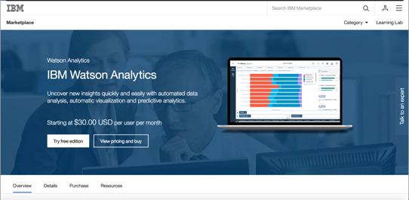
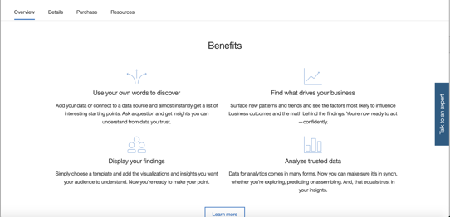
Watson Analytics – October 2016

Slide 32
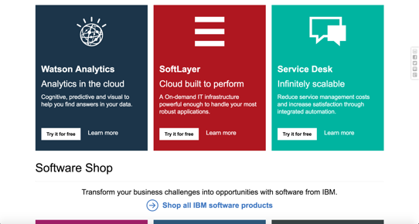

Landing Page: September 2015, November 2016

Slide 33
Designers in squads
Getting the balance right takes practice
Zero designers – ugly user interfaces
7 designers to 9 developers – developers look slow
Depends on the squad. Try 1 designer to 4 developers.

Slide 34
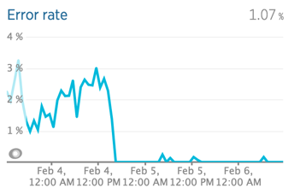
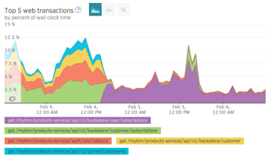
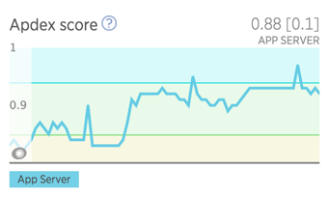
What’s next: becoming more data driven
Usability studies
A/B Testing
Traffic and heatmap data
Other analytics
Monitoring feedback

Slide 35
Major challenges: what I’m hoping to learn
Planning for 1-week sprints is very difficult
Break changes down into small stories, small designs
Stories must be clear, well-defined, detailed acceptance criteria
All dependencies must be ready to go
Planning misses lead to false starts and un-necessary delays
Coordinating changes across squads is very difficult
Conflicting priorities
Managing dependencies
Chained dependencies create long lead times
Urgent requirements coming in from every direction
Preventing burn out

Slide 36

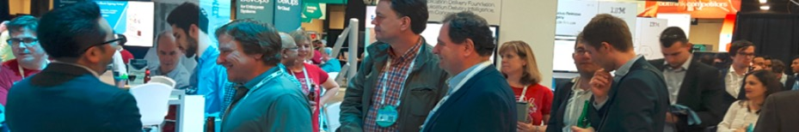
InterConnect 2017 is the premier conference for cloud education and skills development. This year's curriculum will focus on Cloud, Hybrid, Internet of Things, Cognitive, Security, Managed Services and much more.
Submit your DevOps speaker proposal under these sub-topics
Application Lifecycle Management
Application Management
Application Security
Continuous Delivery & ARA
DevOps for Administrators
Development & Continuous Integration
DevOps for Mobile
DevOps for z Systems
Enterprise DevOps Transformation
IT Operations Analytics
IT Operations Management
Methods & Toolchains
Microservices
Software Testing
Call for Speakers closes on November 11, 2016. To learn more visit: http://ibm.com/interconnect

Slide 37
Contact Info
amfred@us.ibm.com
@DukeAMO
See also: free Bluemix Garage Method handouts, IBM booth, and https://www.ibm.com/devops/method/category/practices
Thank You!

